Slide 1
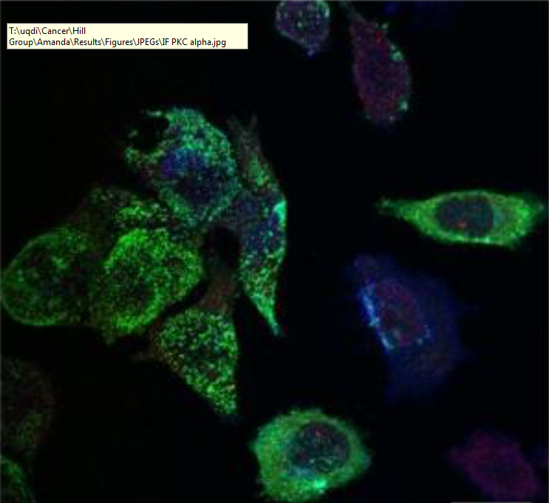
Selective export of microRNA via extracellular vesicles
Harley Robinson
Supervisor: Dr Michelle Hill
Co-supervisor: Dr Alex Cristino

Slide 2
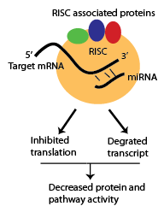
microRNAs
Usually range between 17-24 nucleotides long.
Binding to target mRNA decreases protein function by RISC inhibition and degradation
Export of microRNAs (miRs) regulates pathways in the recipient cells attributed to:
Cardiac homeostasis
Diabetes
Cancer metastasis
Notes:
RISC- RNA induced silencing complex.
Risc associated proteins: argonates, Dicer,

Slide 3
Extracellular vesicles
Composed of microvesicles and exosomes.
Surface contains homing proteins to allow for cell specific delivery
Contents regulates processes in other cells.
Protein sorting

Slide 4
Current Cargo Loading Mechanisms: miRNA

Slide 5
Advanced Prostate Cancer Cell Line: PC3

Slide 6
Cavins and lipid rafts

Slide 7
miRNA, caveolin, cavins

Slide 8
Hypotheses and Aims:

Slide 9
Aim 1: Analysis of miRNA export

Slide 10
Bioinformatics

